Slide 1
Growing and Engaging Your Club Membership
Lori Fickling, Cross Timbers Rotary, District 5790, Assistant Governor Area 6

Slide 2
Hello!
I am Lori Fickling
I’m here because I love to give presentations.

Slide 3
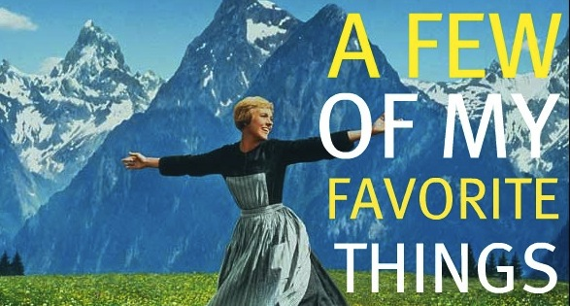
What do you like most about your Rotary club?

Slide 4


What needs improvement in your Rotary club?

Slide 5


Rethink Your Club
It’s never too late!
Why does it matter?
What do we want to be?

Slide 6

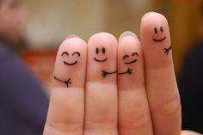
Are you a welcoming club?
OR?
Is it more like “Us 4 and No More?”

Slide 7

Who do you enjoy having lunch
(or breakfast) with?

Slide 8
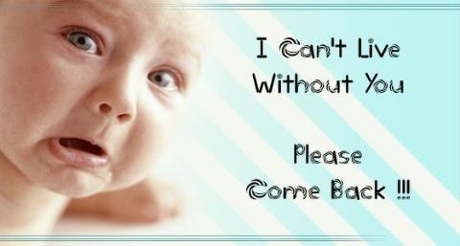
Bring them back

Slide 9

Couples that Rotary together…

Slide 10
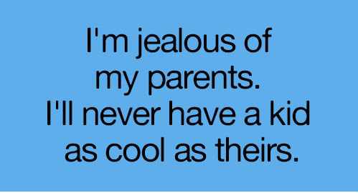
What are your adult
children doing now?

Slide 11

Everyone Has a Story
What’s Yours?

Slide 12


Slide 13

Perfect Attendance Engagement
Don’t hang on to old rules.

Slide 14

Keeping Your Members Engaged

Slide 15
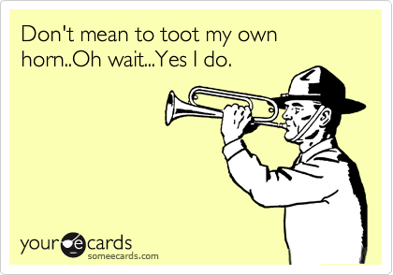
Toot Your Own Horn!

Slide 16

Building On Success
Promotion
Social Events
Fundraising
Service Projects

Slide 17
ALONE WE CAN DO SO LITTLE;
TOGETHER WE CAN DO SO MUCH.
- - Helen Keller

Slide 18
Many Thanks!
Any questions?
You can find me at LoriFickling@gmail.com.

